Slide 1

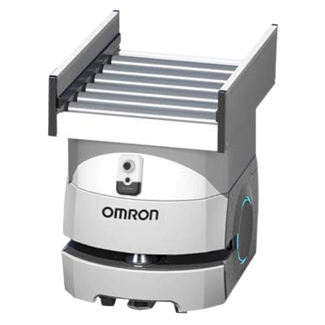

SMART MOBILITY:
AUTOMATED GUIDED VEHICLE TRAFFIC ANALYSIS
Student: Bălteanu Andreea - Iuliana
Mentor: Biriș Cosmin

Slide 2
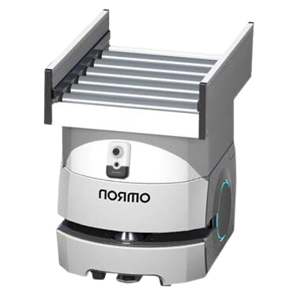




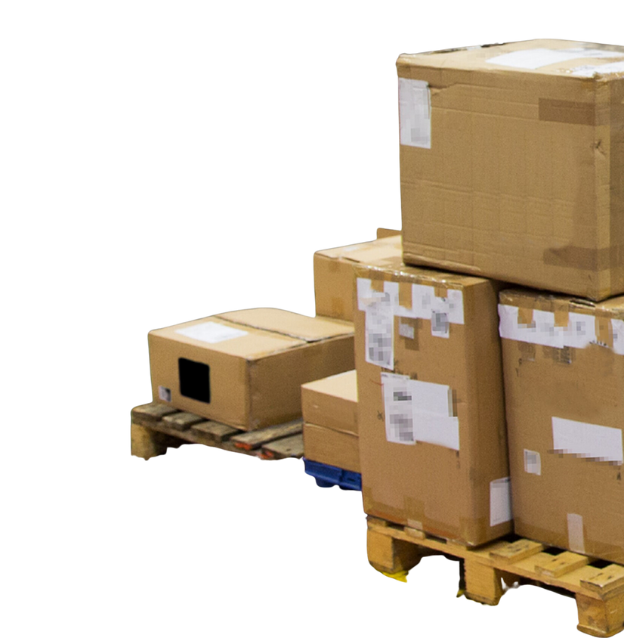

SMART MOBILITY:
AUTOMATED GUIDED VEHICLE TRAFFIC ANALYSIS
When an event happens, a frame is taken from the streaming using a FFMPEG command in Node-RED.
The analysis results and the robot’s coordinates are stored in an Oracle database.
The image is then analyze by the Custom Vison service from Microsoft Azure.
The updated reports are displayed in the Node-RED interface.

